Slide 1
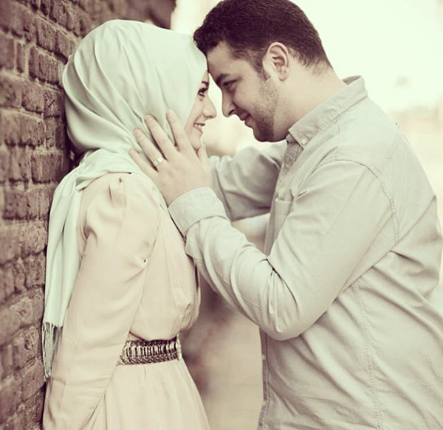
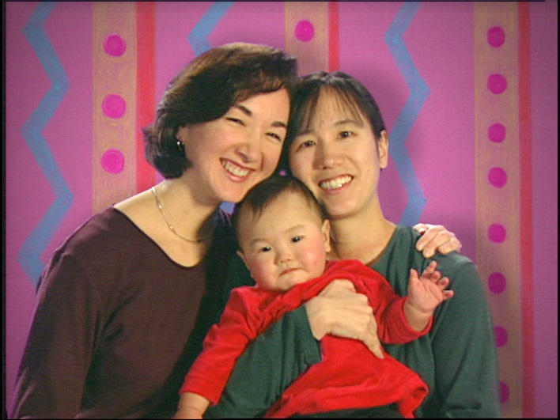
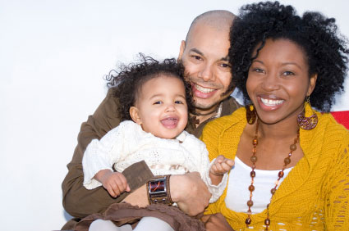
Unit 1: All in the Family

Slide 2
What is a Family?
The Vanier Institute of the Family defines families as:
...any combination of two or more persons who are bound together over time by ties of mutual consent, birth and/or adoption or placement and who, together, assume responsibilities for variant combinations of some of the following:
Physical maintenance and care of group members
Addition of new members through procreation or adoption
Socialization of children
Social control of members
Production, consumption, distribution of goods and services, and
Affective nurturance — love

Slide 3
Who Studies the Family?
Sociologists:
WHO: interactions between/among groups
WHAT: institutions: family, peers, church, school, media
HOW: methods: statistics, interviews, case studies
Psychology:
Mind + emotions
Motivations: actions may derive from and affect families
Methods: clinical experiments and questionnaires
Anthropologists:
Physical and cultural development of humans
Beliefs, rituals, values, structures, especially kinship and family structures
Methods: participant observation

Slide 4
Terminology for reference/understanding
Nuclear family: parent or parents and their children
Conjugal family: married parents and kids
Extended family: nuclear/conjugal plus other relatives in same dwelling.
Ex. Beverly Hillbillies
Supra-family: other relatives you don’t live with.
Ex. Grampa Simpson

Slide 5
Symbolic Ethnicity: when many original “ethnic” values and attitudes are lost but may be hyphenated.
Ex. Ukranian – Canadian
Ego-Extension: group identity is an essential part of individual identity.
Exogamy: marrying outside cultural or religious group.
Endogamy: marrying inside a cultural or religious group.
Marginality: one of the problems of ethnicity; feeling of being outside a group.

Slide 6
Functions of the Family
1. Socialization
Definition: the process by which children learn to become human and adopt certain behaviour.
All behaviour is learned
Language, rules, responses, walking, cooperation (or not), values, emotions and coping, gender roles.
Proof: feral children (wild) or isolates:
Rare children for some reason have been deprived of all human contact during their early years.
Isolates are children who have had little human contact, and not the kind that would teach them human behaviour
Need role models as an example for behaviour
Role models provided by parents affect the way children speak, behave, and even think.

Slide 7
2. Economic Function
Means for supplying children with necessities
Definition: families are the means whereby children are supplied with the necessities; food, clothing, and shelter, medical care and education.
Then: kids worked in home, factory, farm to help ensure survival of the family unit.
Now: children have a childhood and are dependent.
Family evolved from a unit of work to a unit of consumption.

Slide 8
Reproductive Function:
To replace people who die with kids for population sustainment/growth.
Essential task of having children and raising them to become active, contributing members of society.
Today: some concern for declining birth rates ( contraception )
Immigration needed to maintain population

Slide 9
Sexual Function
Sexual bond between a couple, which provides for the sexual needs of both
The “glue” that holds the family together
Contraception:
Then: women pregnant all the time or sexual limitations
Now: good: can be more sexually free within a marriage
Bad: can be more sexually free outside a marriage
*sexually transmitted diseases or STIs

Slide 10
Emotional Function
Provides psychological support for family members
People who have been deprived of close family relationships in childhood may have emotional problems as adults.
These people may have difficulty meeting the emotional needs of their future family (cycle)

Slide 11
John Porter (Canadian sociologist, wrote The Vertical Mosaic 1965)
Social class depends on three things:
education
income
occupation
*all 3 determine how much power a person has.
Power: “the right that some people have to direct the affairs of others.”
Past – people inherited power (or the lack of it)
Ex. Born poor, stay poor
Industrialization: changed these attitudes of acceptance and opened up new opportunities for
Social mobility: the ability to move from one social class to another
-due to education

Slide 12
upper class: well-to-do, may trace family wealth and history
upper middle class and lower middle class:work for wages or salaries
under class: live below the poverty line
If education is key to our social mobility, then consider how socialization affects our desires for education.

Slide 13
Kohn finds these differences between upper-middle class family and the working class family:
Upper-middle class
Stress the abstract: independence, success, confidence
Punishment is not normally physical, explanations used
Concerned with motives
Working Class
Are more physical than abstract.
Want their kids to follow orders, not think on their own.
Not concerned with motives. Little explanation is offered.

Slide 14
According to Gans:
Upper-middle class families
parents have clear expectations for their kids.
They encourage university, but your own path.
Lower-middle class families
want their kids to be happier than they were.
Parents make sacrifices for their kids, and are very involved in their lives.
Working class families
children are to follow their parents wishes while at home.
They can follow their own interests.
Parents are not involved in the outside activities of their kids.
Peer groups plays a major role.

Slide 15
Porter says it is possible to determine if you will go to university by looking at the social class of your family. (agree or disagree)
Social mobility exists in Canada – but Porter states that the under class have fewer chances of moving.
WHY?
Money offers increased experiences (camp, trips, extra courses) and more role models.
Elkin and Handel believe that you inherit the social class of your parents. Why?
Because of socialization. The family is the first reference group, so the values and attitudes are adopted by the children.
Children tend to associate with the same type of children (neighbourhood, school, religious, ethnic)
Class attitudes are often taken from the parents (what you overhear – good or bad)

Slide 16
Theoretical Perspectives: Developmental Theories

Slide 17
Structural Functionalism:
Society functions like a body; each part works independently to benefit the whole.
Is the sociological theory that attempts to explain how a society is organized to perform its required functions effectively
Is the oldest sociological theory, and also used by anthropologists
Ex. Law, political system, family (called institutions)
Uses a macro approach that assumes the organization of society is based on a consensus about what is functional.

Slide 18
Functionalists:
Examine the roles that individuals play within an institution such as the family
Ex. Students attend class, ask questions…
Make observations about role behaviour and determine the rates at which various behaviours occur.
The most prevalent behaviours are norms.
Ex. A husband who stays at home is abnormal.
A problem is that functionalists sometimes go beyond explaining how a society is organized and tells it how it should behave.

Slide 19
Systems Theory:
The sociological theory that attempts to explain how groups of individuals interact as a system. Ex. Ballet.
Family systems have special characteristics; they maintain a relatively stable size, and can leave only by death.

Slide 20
Symbolic Interactionism:
Is a psychological theory that attempts to explain how individual choose how they will act based on their perceptions of themselves and of others.
It is based on 3 concepts:
1. a self has 2 parts:
“me” self: self that is shown to the outside world
“I” self: true self, self that is who are on the inside
the closer the two selves are to each other, the happier the individual will be.

Slide 21
2. role-taking: the basis for human interaction
anticipate what the other will do and decide based on that how they will respond
3. people need a common language to communicate
a limitation is the possibility that because the researcher uses perceptions and interpretations, the observations could be influenced by the researcher’s personal beliefs and self-image.
“I am not who I think I am, I am not who you think I am, I am who I think you think I am.”

Slide 22
Social Exchange Theory
is a psychological theory that attempts to explain the social factors that influence how the individuals interacts within reciprocal relationships.
They can be used to explain choices of marriage partners – the benefits must outweigh the costs to stay in a relationship. PRO/CON

Slide 23
Feminist Theories p.45-46
A look at the impact of sex and gender on behaviour
Roots in conflict theory, but were developed to separate sex and gender from class.
Androcentricity: male behaviour is human behaviour. Change is required so all needs are met.
There are three categories:

Slide 24
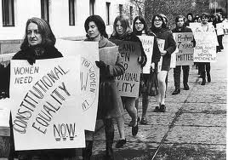
Liberal Feminism
Discriminatory policies force women into inferior social class that restricts rights
Try to change social policy through political means.

Slide 25
Socialist Feminism
The status of women is social inequality rooted in sexual division of paid and unpaid labour.

Slide 26
Radical Feminism
The differences in power between men and women result in any male/female relationship as being exploitative.
A separate female culture can correct this.

Slide 27
The Ecological Perspective
A psychological theory that sees individuals and families as members of interlocking systems within society that influence each other
Developed by Urie Bronfenbrenner 1979
Looks at behaviour in terms of impact of society: social policy, technological change, cultural diversity
Ex. Economic uncertainty → higher unemployment → family conflict about education choices
Combines systems theory and developmental theory

Slide 28
Society influences indiv and fam on four levels:
microsystem:
each individual develops behaviour to meet own needs
mesosystem
small groups, ex. Family socializes individually based on how society has influenced them
exosystem:
socio-economic environment
extended family, school, employment
sets expectations and influences available resources
macrosystem:
socio-cultural environment
the society in which the person lives, includes ideology and policies that limit behaviour

Slide 29
The Life Course Approach * also called developmental theory
Examines biological, psychological, social and cultural factors that influence development.
Describes predictable stages in behaviour as people progress through various stages
Ex. teen years, leaving home, married couple, couple with young children, couple with teens, empty nest, retirement, death

Slide 30
As they develop, they face role expectations that challenge development, called “developmental tasks”. For example, Erikson: indiv develop identities separate from parents
Have to be careful in determining whether differences are caused by age-stage or by social change ex. cohort effect – baby boomers
Also, just because groups of people may follow a specific path, doesn’t mean it’s a) the right path or b) the only path
Family life cycle framework – applies developmental perspective to life course of indiv.
Normative events: marriage, birth of a child, child leaving home
Non-normative events: death of a child, adultery
Non-normative events presents unique challenges

