Slide 1
Unit 3
Couples and Relationships

Slide 2
Dating
20th century invention
it is now a recreation; not someone you have to marry
at the turn of the century: mate selection was made for you (parents/circumstance)
rural: selection for mate was very poor, very limited houses in your vicinity
no dating: if you met, you got married
Technological advances has allowed us the freedom to date

Slide 3
Dating Emerges due to:
Extension of co-education/compulsory education
Forced to be with your age group at school and forced to be there
You are not working on your own, are at school with students and teachers
You are forced to interact with these people that leads you to getting to know them better
You spend a lot of time together
You have a variety of people to choose from now
School gives you an education therefore allows you to open doors and you can share this with someone – bond.

Slide 4
Continuing Emancipation or liberation of Women
women have more choice to select who they want to marry OR not to marry. You don’t have to get married but continue education (make own choices)
General Emancipation of Youth from Parental Control
There are many places you can go to be away from parents
No longer under strong watch of parents
Parenting methods have changed
Society’s attitude has changed: daycare, freedom of youth
Family: dual income parents = less hours home with youth

Slide 5
Rising Standards of Living
Gives us the opportunity to buy extra things (ex. Toys) a lot more disposable income
Technology gives us more leisure time for recreation
Increased Mobility
Cars and buses
Able to get around instead of staying in with parents, able to go out
Getting your license, freedom and responsibility

Slide 6
The Love Chronicles: Sexual Chemistry
Name 3 traits associated universally with female desirability.
Youth + beauty = fertility and good genetics
Clear skin, eyes
High estrogen, low testosterone = shorter jaw, full lips
Symmetrical face
0.7 ratio waist/hips
According to evolutionary psychologist Dr. Devendra Singh at the University of Texas, the ideal female ratio is 0.7 (ie, the waist is 70 per cent of the hip measurement). Waist-to-Hip Ratio or Waist-Hip Ratio (WHR) is the ratio of the circumference of the waist to that of the hips.

Slide 7
For males the ideal is more like 0.85 or 0.9. A WHR of 0.7 for women and 0.9 for men have been shown to correlate strongly with general health and fertility.
Women within the 0.7 range have optimal levels of estrogen and are less susceptible to major diseases such as diabetes, cardiovascular disorders and ovarian cancers.
Men with WHRs around 0.9, similarly, have been shown to be more healthy and fertile with less prostate and testicular cancer.

Slide 8
Such diverse beauty icons as Marilyn Monroe, Christina Hendricks, Sophia Loren, Kate Moss, Salma Hayek and even the Venus de Milo all have ratios around 0.7, even though they have significantly different weights. Congruent with an evolutionary perspective, evidence suggests that humans use subtle biological cues, such as WHR, to indicate mate potential and fertility.

Slide 9
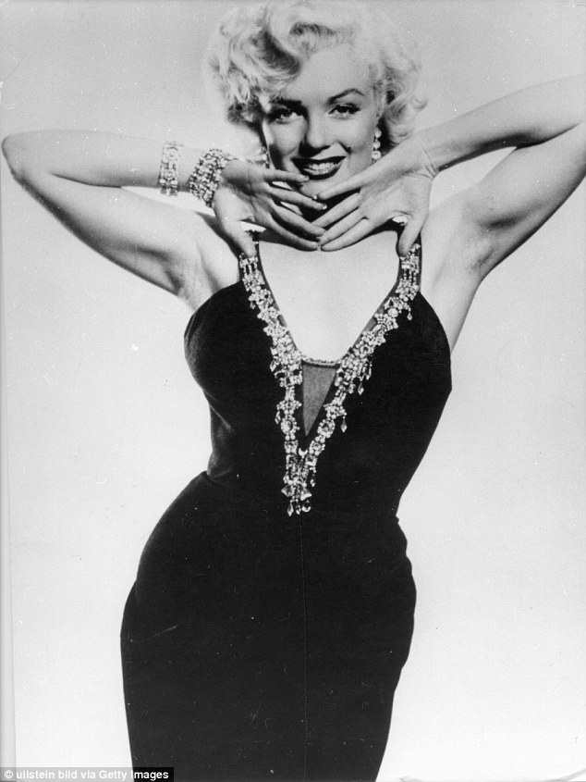
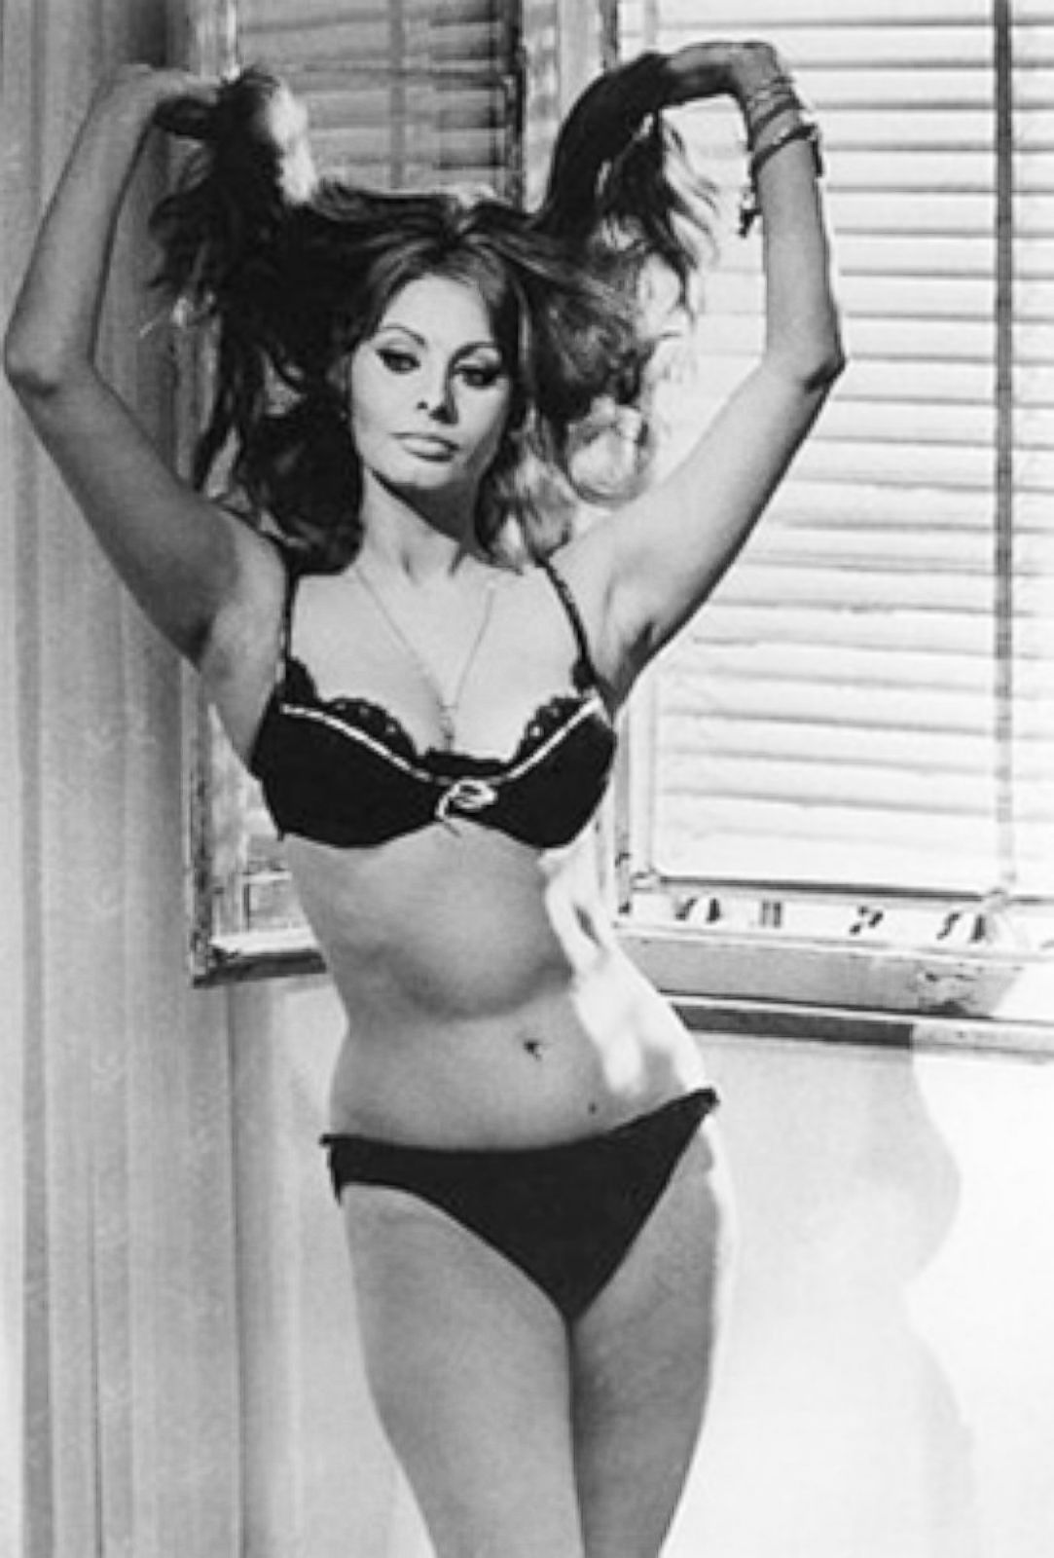

Slide 10
Name two traits associated universally with male desirability.
Less testosterone
Ability to acquire resources (job, education, status)
Name 2 different ways men and women draw attention to themselves.
Men: loud laugh, physically take up territory
Women: noisy heels, eye flutter, hair toss, coy
Copulatory gaze (lasts 2-3 seconds)
After drawing attention to themselves, what are the next 3 steps in courtship?
ease of conversation
Touch
body synchrony (dancing)
Love Notion #9
What are pheromones?
Colourless, odourless secretions linked to desire
What is the VNO?
Gland which receives pheromones

Slide 11
Describe Fisher’s 3 stages of love:
Lustful Love: short lived, burst of passion
Limerance: obsessive desire, intrusive thinking, intense and addictive
Attachment or Break-Up deep long term commitment or dies
What is the key factor in having a significantly happier marriage?
Indulge in thrills together
Love at First Sniff
What did Hirsch find were the top “attraction” smells for men?
Lavender and pumpkin pie
Donuts and black licorice
Donuts and pumpkin pie
Vanilla and strawberry
*all better than perfumes
For women?
Black licorice and cucumber
Banana nut bread
What were women’s turn-offs?
Cherries
Cologne
Roasting meat
What kind of body odour is a turn-off for everyone?
Scents that are too similar – genetic similarities

Slide 12
What is the purpose of kissing?
Flavour/smell of a person
Everyone wants a kiss to taste fresh, except for single men, who prefer a kiss to taste like alcohol.
Love, Pavlovian Style
When do we begin to form our mental image of the ideal mate?
5-8 years old begin list (love map)
by teens it’s concrete
What are 5 love predictors?
meeting in a stimulating environment
opposites attract: hide/accentuate own personality
measuring up to mother – both men and women
other people’s opinions
discovering someone likes you

Slide 13
BBC The Human Face: Beauty
https://www.youtube.com/watch?v=bryEhwNN6oE

Slide 14
3 Predictable stages of a relationship:
Stage 1:
Relationships are romantic, warm, and respectful, focusing on exploration, sexual attraction, and the idealization of the partner.
Individuals also build self-esteem as they try to develop the relationship they want.

Slide 15
Stage 2:
Conflict arises as individuals become more demanding to meet their own needs.
Results in instability in the relationship and requires both partners to change their behaviour.
May feel let down because the relationship is less rewarding.

Slide 16
Stage 3:
Couples compromise and negotiate a relationship that meets their needs as well as possible.
Relationship becomes more realistic, mature, and stable.
Key to surviving stage 2 is to be honest about your needs and become more flexible in your role.

Slide 17
Crises (normal and predictable) cause the instability of stage 2 to recur and require the couple to renegotiate their relationship repeatedly.
Predictable developmental crises include:
Adjustment to marriage
Birth of a child
Teenage years
Children leaving home
Retirement
Growing old together
Some couples will also be challenged by non-normative crises, such as unemployment, infertility, illness or infidelity.
p.208 in focus Matrimony as the Ultimate Adventure
p.206 FYI Nine “Psychological Tasks” Needed for a Good Marriage

Slide 18
The Purpose of Marriage
Marriage: a socially legitimate sexual union, begun with a public announcement and with some idea of permanence, and assumed with a more or less explicit contract.
In Canada: most 1st relationships = conjugal, common law, cohabitation without marrying.
Marriage is a rite of passage & signifies transition to adulthood (across societies).
Pair-Bond: the enduring relationship between a male and a female, thought to be essential to human survival (Helen Fisher)
Helen Fisher (American Anthropologist)
Reproducing & protecting children needed to continue existence.
Male and female have a biological urge to reproduce.
Functionalists: Marriage necessary in the organization of society (marriage as a social invention).
People happiest when they marry because they serve useful purposes for society.

Slide 19
Personal Reasons:
Adult status
Better standard of living (pool resources)
Help form person’s identity, sense of purpose
Commit to someone
Social Exchange Theory: belief that being married is better than being single (pro vs con)
21st century, many people not marrying
marriage rate is down, although couples forming conjugal relationships is increasing.
Common Law: intimate relationship (cohabitation) within a couple. To live together without legally marrying.

Slide 20
The Wheel Theory of Love
Developed by Reiss (1980)
Studied how people truly fall in love
If moving clockwise on the wheel = fall in love
Counter clockwise = out of love
Two people may not be at same point/not necessarily together

Slide 22
Rapport
Find you make a connection with other person
Original attraction to person
Examples:
Physical appearance
Mannerisms
Personality
Sense of humour
Maturity
Vivaciousness, outgoing
Confidence in themselves
Cheerfulness
Personal hygiene
Ability to communicate
Compassion
Doesn’t necessarily have to move on from here

Slide 23
Self-revelation
Start telling things about yourself
Start slowly, a little mystery is appealing
As they are accepted and encouraged by the other person, start telling more
It should be mutual
Might find out something you don’t like – back up or fall off

Slide 24
Mutual dependency
You think you are in love but you are not.
You need each other because you are a couple
Not known as yourself, become one unit i.e. Brangelina
Need for social purposes, companionship
“coupleness” becomes important
do couple things like give flowers, hold hands, engage in the following dialogue:
“I love you.”
“No, I love you.”
“No way can you love me more than I love you.”
“You hang up first…”
cute, but not in love b/c you are meeting each other’s needs to fulfill expectations
if you marry here you are not married for love

Slide 25
Intimacy need Fulfillment
Congratulations! You are in love!
Hard to define
Finally in love when other person fulfills intimate needs:
they understand you
accept you the way you are (not how you are pretending to be)
your well-being is one of the most important things in their life
willing to make sacrifices for each other.
Intimacy: you want to do things for them, high commitment level
If this person was out of your life = tragedy

Slide 26
All of this happens within
Role Conceptions: everyone has an idea of what they should be as a girlfriend or how a boyfriend should act.
“for me a boyfriend/girlfriend is (what you are looking for).”
Can’t change yourself to fit another person’s idea
If so, this is not going to last. If they don’t want you for who you are – forget it!

Slide 27
Gary Chapman’s The Five Love Languages
Words of Affirmation
Quality Time
Receiving Gifts
Acts of Service
Physical Touch

Slide 28
Mark Twain once said “I can live for two months on a good compliment.” Verbal appreciation speaks powerfully to persons whose primary Love Language is “Words of Affirmation.” Simple statements, such as, “You look great in that suit,” or “You must be the best baker in the world! I love your oatmeal cookies,” are sometimes all a person needs to hear to feel loved.
Aside from verbal compliments, another way to communicate through “Words of Affirmation” is to offer encouragement. Here are some examples: reinforcing a difficult decision; calling attention to progress made on a current project; acknowledging a person’s unique perspective on an important topic. If a loved one listens for “Words of Affirmation,” offering encouragement will help him or her to overcome insecurities and develop greater confidence.

Slide 29
Quality Time
Quality time is more than mere proximity. It’s about focusing all your energy on your mate. A husband watching sports while talking to his wife is NOT quality time. Unless all of your attention is focused on your mate, even an intimate dinner for two can come and go without a minute of quality time being shared.
Quality conversation is very important in a healthy relationship. It involves sharing experiences, thoughts, feelings and desires in a friendly, uninterrupted context. A good mate will not only listen, but offer advice and respond to assure their mate they are truly listening. Many mates don’t expect you to solve their problems. They need a sympathetic listener.

Slide 30
An important aspect of quality conversation is self-revelation. In order for you to communicate with your mate, you must also be in tune with your inner emotions. It is only when you understand your emotions and inner feelings will you then be able to share quality conversation, and quality time with your mate.
Quality activities are a very important part of quality time. Many mates feel most loved when they spend physical time together, doing activities that they love to do. Spending time together will bring a couple closer, and, in the years to come, will fill up a memory bank that you can reminisce about in the future. Whether it’s sitting on the couch and having a brief conversation or playing together in a tennis league, quality time is a love language that is shared by many. Setting aside focused time with your mate will ensure a happy marriage.

Slide 31
Receiving Gifts
Some mates respond well to visual symbols of love. If you speak this love language, you are more likely to treasure any gift as an expression of love and devotion. People who speak this love language often feel that a lack of gifts represents a lack of love from their mate. Luckily, this love language is one of the easiest to learn.
If you want to become an effective gift giver, many mates will have to learn to change their attitude about money. If you are naturally a spender, you will have no trouble buying gifts for your mate. However, a person who is used to investing and saving their money may have a tough time adjusting to the concept of spending money as an expression of love. These people must understand that you are investing the money not in gifts, but in deepening your relationship with your mate.

Slide 32
The gift of self is an important symbol of love. Sometimes all your mate desires is for someone to be there for them, going through the same trials and experiencing the same things. Your body can become a very powerful physical symbol of love.
These gifts need not to come every day, or even every week. They don’t even need to cost a lot of money. Free, frequent, expensive, or rare, if your mate relates to the language of receiving gifts, any visible sign of your love will leave them feeling happy and secure in your relationship.

Slide 33
Acts of Service
Sometimes simple chores around the house can be an undeniable expression of love. Even simple things like laundry and taking out the trash require some form of planning, time, effort, and energy. Doing humble chores can be a very powerful expression of love and devotion to your mate.
Very often, both pairs in a couple will speak to the Acts of Service Language. However, it is very important to understand what acts of service your mate most appreciates. Even though couples are helping each other around the house, couples will still fight because the are unknowingly communicating with each other in two different dialects. For example, a wife may spend her day washing the cars and walking to dog, but if her husband feels that laundry and dishes are a superior necessity, he may feel unloved, despite the fact that his wife did many other chores throughout the day. It is important to learn your mate’s dialect and work hard to understand what acts of service will show your love.

Slide 34
It is important to do these acts of service out of love and not obligation. A mate who does chores and helps out around the house out of guilt or fear will inevitably not be speaking a language of love, but a language of resentment. It’s important to perform these acts out of the kindness of your heart.
Demonstrating the acts of service can mean stepping out of the stereotypes. Acts of service require both mates to humble themselves into doing some chores and services that aren’t usually expected from their gender. However, these little sacrifices will mean the world to your mate, and will ensure a happy relationship.

Slide 35
Physical Touch Many mates feel the most loved when they receive physical contact from their partner. For a mate who speaks this love language loudly, physical touch can make or break the relationship.
Sexual intercourse makes many mates feel secure and loved in a marriage or relationship. However, it is only one dialect of physical touch. Many parts of the body are extremely sensitive to stimulation. It is important to discover how your partner not only physically responds but also psychologically responds to these touches.
It is important to learn how your mate speaks the physical touch language. Some touches are irritating and uncomfortable for your mate. Take the time to learn the touches your mate likes. They can be big acts, such as back massages or lovemaking, or little acts such as touches on the cheek or a hand on the shoulder. It’s important to learn how your mate responds to touch. That is how you will make the most of this love language.

Slide 36
All relationships will experience crisis. In these cases, physical touch is very important. In a crisis situation, a hug can communicate an immense amount of love for that person. A person whose primary love language is physical touch would much rather have you hold them and be silent than offer any advice.
It is important to remember that this love language is different for everyone. What type of touch makes you feel secure is not necessarily what will make your partner happy. It is important to learn each other’s dialects. That way you can make the most of your hugging, kissing, and other physical contacts.

Slide 37
http://www.5lovelanguages.com/
https://www.youtube.com/watch?v=U4FTBKpxw1U

Slide 38
The Five Languages of Apology

Slide 39
Expressing Regret “Expressing Regret” is the Apology Language that zeroes in on emotional hurt. It is an admission of guilt and shame for causing pain to another person.
For those who listen for “Expressing Regret” apologies, a simple “I’m sorry” is all they look for. There is no need for explanation or “pay back” provided the apology has truly come from the heart.
“Expressing Regret” is a powerful Apology Language because it gets right to the point. It doesn’t make excuses or attempt to deflect blame. Above all, “Expressing Regret” takes ownership of the wrong. For that reason, “Expressing Regret” is understood as a sincere commitment to repair and rebuild the relationship.
The “Expressing Regret” Apology Language speaks most clearly when the person offering the apology reflects sincerity not only verbally, but also through body language. Unflinching eye contact and a gentle, but firm touch are two ways that body language can underscore sincerity.

Slide 40
Accept Responsibility
It is very difficult for some people to admit that they’re wrong. It makes them doubt their self-worth, and no one likes to be portrayed as a failure. However, as adults, we must all admit that we will make mistakes. We are going to make poor decisions that hurt our mates, and we are going to have to admit that we were wrong. We have to accept responsibility for our own failures.
For many individuals, all they want is to hear the words, “I am wrong.” If the apology neglects accepting responsibility for their actions, many partners will not feel as though the apology was meaningful and sincere. Many partners need to learn how to overcome their ego, the desire to not be viewed as a failure, and simply admit that their actions were wrong. For a mate who speaks this apology language, if an apology does not admit fault, it is not worth hearing. Being sincere in your apology means allowing yourself to be weak, and admitting that you make mistakes. Though this may be hard to do for some people, it makes a world of a difference to your partner who speaks this language.

Slide 41
Make Restitution
In our society, many people believe that wrong acts demand justice. The one who commits the crime should pay for their wrongdoing. A mate who speaks this love language feels the same way towards apologies. They believe that in order to be sincere, the person who is apologizing should justify their actions. The mate who’s been hurt simply wants to hear that their mate still loves them.
There are many effective ways to demonstrate sincerity in an apology. Each mate must learn the other’s love language in order to complete the act of restitution. Though some mates may feel a though all is forgotten with a bouquet of flowers, that may not necessarily work for all mates. Every mate should uncover what their partner’s main love language is (Words of Affirmation, Quality Time, Acts of Service, Physical Touch, and Receiving Gifts) and use that specific language in order to make restitutions in the most effective way.
For a mate whose primary apology language is making restitutions, no matter how often you say “I’m sorry”, or “I was wrong”, your mate will never find the apology sincere. You must show strong efforts for making amends. A genuine apology will be accompanied by the assurance that you still love your mate and have a desire to right the wrong-doings committed.

Slide 42
Genuinely Repent For some individuals, repentance is the convincing factor in an apology. Some mates will doubt the sincerity of an apology if it is not accompanied by their partner’s desire to modify their behavior to avoid the situation in the future.
It’s important to remember that all true repentance begins in the heart. A mate must feel poorly for hurting their loved one, and truly want to change. Admitting you are wrong creates vulnerability. It allows your mate to get a glimpse of your heart. The glimpse of true self is assurance that the apology was sincere.
One important aspect of genuinely repenting is verbalizing your desire to change. Your mate cannot read your mind. Though you may be trying to change inside, if you do not verbalize your desire to change to your mate, most likely they will still be hurt.
Many people have problems with repenting when they do not feel as though their actions were morally wrong. However, in a healthy relationship, we often make changes that have nothing to do with morality and everything to do with building a harmonious marriage or relationship.
It is also important to make a dedicated plan for change. Often apologies involving repentance fail because the person never set up steps of action to help ensure success. A person must first set goals for their change. After you create realistic goals, then you can start implementing a plan to change. Taking baby steps towards repentance instead of insisting on changing all at once will increase your chances of successfully changing your ways.
It is important to remember that change is hard. Constructive change does not mean we will immediately be successful. There will be highs and lows on the road to change.

Slide 43
Request Forgiveness In some relationships, a mate wants to hear their partner physically ask for forgiveness. They want assurance that their mate recognizes the need for forgiveness. By asking forgiveness for their actions, a partner is really asking their mate to still love them. Requesting forgiveness assures your mate that you want to see the relationship fully restored. It also proves to your mate that you are sincerely sorry for what you’ve done. It shows that you realize you’ve done something wrong. Requesting forgiveness also shows that you are willing to put the future of the relationship in the hands of the offended mate. You are leaving the final decision up to your partner – to forgive or not forgive.
Requesting forgiveness is not easy. It often leaves one vulnerable to the fear of rejection. Along with the fear of rejection is the fear of failing. Many people have a hard time seeking forgiveness because it means admitting that you have failed. The only way to overcome this fear is to recognize that it is very common amongst mankind. The commonality makes it okay to be a failure. It allows a stubborn mate to apologize to their partner and become a healthy individual.
Ultimately, it’s important to remember that there is a difference between asking for forgiveness and DEMANDING forgiveness. When we demand forgiveness, we tend to forget the nature of forgiveness. Forgiveness is a choice the offended party is supposed to make. Demanding forgiveness takes away the sincerity of asking for it.
Remember not to treat forgiveness lightly. It is something to be cherished and appreciated. The act of forgiveness is hard on both ends – for the person who’s asking and for the person who’s accepting

Slide 44
How to Be a Crazy Girlfriend
https://www.youtube.com/watch?v=h-rJbCisU4E

Slide 45
Dating and Marital Success
Our society tends to support market experience theory and most people would agree that your first dating partner is probably not the best choice.
Martin King White studied couples in Detroit
Found no correlation between dating experience and marital success
Being in love at time of marriage was the best indicator of success
In free-choice marriage, you can only “test drive” one partner at a time. If you change your mind later, that person may be unavailable. You have to decide before you have all your options in.
Ironically, in arranged marriage you are presented with all the options at once and choose the best one.
Dating rules have changed over the 20th century
Exclusivity is expected earlier in the relationship. “seeing someone” implies the same exclusivity not required before “going steady”
Shift from partners competing to people being more selective
Less formal courtship patterns mean it’s more challenging for individuals to negotiate the selection of a partner.

Slide 46
P. 162 – 166
Define:
Marriage
Conjugal relationship
Pair-bond
Common-law
Cohabitation
Betrothal
Bride price
Dowry
Dower rights
Marriage contract
Patrilocal
Banns
Matrilocal
Life Table Estimates of First Marriage: Canada, 1990 p. 170
The Conjugal Relationships of Canadian Women p.171
Why Men Marry p.173

Slide 47
Stimulus-Value-Role Theory
Builds on both the Social Exchange Theory and the Filter Theory
Stimulus:
start a partnership because of physical attractions, social compatibility, etc.
This is the first screening stage. It will also include aspects like status and personality. If the rewards are greater than the cost, you will move on.
Value:
sort through attitudes and values related to sex, religion, marriage, children, and lifestyle. The stronger the similarities (homogamy), the more compatible.
Role:
the pair see how values and attitudes are expressed in actual situations. If the benefits are positive then they may get married.

Slide 48
Arranged Marriages
2 types:
1. involves a bride price
2. the bride is provided with a dowry from her father (keeps social classes separate.)
*This is decreasing because of education.
Arranged marriages in Canada: the gov’t of France (1663) arranged marriages to encourage growth in New France. Normally women from poor families or orphaned were provided with dowries from the government; called filles du roi.

Slide 49
Problems, Conflict and Power
Conflict is a natural part of relationships and society
Individual vs. collective interest
Women’s rights vs. male entitlement
Mine vs. yours
Especially with the
Division of labour
Expressive quality of the relationship (intimacy)
Principle of Least Interest
Person with the least interest has more power b/c the other is more likely to give in.

Slide 50
Most Common Problems in relationships
Balance job and family
Frequency of sexual relations
Debt brought into marriage
Husband’s employment
Finances
Household tasks
Men still feel pressure to accept full $$$ responsibility
Women feel they have to raise a family, do housework and maintain a career

Slide 51
Intermarriage
A.K.A. heterogamy – different social, racial, religious or cultural backgrounds
More likely to divorce
More common in urban areas
Increasing in Canada
No legal restrictions
Marital script: behaviours learned in family of origin brought into marriage

Slide 52
Interracial
Study in U.S. in 1997 of black/white couples
Little impact on internal roles
2 challenges:
Dealing with outside prejudice
Raising biracial children, giving them an identity

Slide 53
Interfaith
Chosen attribute – convert
Problems within:
How to compromise – values based
Faith of the children
More likely to succeed if one converts or is non-practicing

Slide 54
Interethnic
Mix of national/racial heritage, religion and culture
Main variations are in:
Gender roles

Slide 55
Socialization and Mate Selection
How you were socialized as a child will influence who you select as a mate.
Some concepts come into play with mate selection:
Exogamy: mating outside family race/culture
Endogamy: select a partner from within own race/culture
Homogamy: being with others who are “like themselves.”
You are normally in contact with the same type of people (school, neighbourhood)

Slide 56
Theories of Mate Selection
Exchange theory:
A satisfactory relationship is one people feel that they gain from OR the rewards outweigh the costs.
Factors we consider when we form a love relationship:
Age
Appearance (may not contribute to success, but taken into consideration with selection)
Status (family background, economic standing, education, job)
Personality (compatible – perception during the falling in love stage may not be realistic)
Companionship (sharing leisure pursuits – intellectual/social – good communication)
Beliefs (religious and political)

Slide 57
Psychological factors play a part in assessing personality in a partner:
Parental influences: through socialization and also how parents relate to each other and you.
Comfortableness: see each other as supporting and non-threatening.
Self-image: you tend to select a partner who sees you as you see yourself.
Response: favourable? Then good.
Psychological homogamy: select people with similar self-acceptance, and self-confidence.
Ideal Image: derived from society and personal

Slide 58
Defining Success
Successful married couples have these things in common:
Having similar values
Enjoying similar leisure time activities
Pooling incomes
Sharing in power and decision-making in relationship
Having friends in common
Having an active social life together
Read p.210-211 Research study:
Why Marriages Succeed or Fail
FYI Claude Guldner’s Six Rs of Marriage p.214 – 215
Read p. 236 – 239 Infidelity
p.240 – 241 Point of view: Protecting a Marriage
Define the following terms in your notes:
Spousal Violence
Domestic violence
Assault
Intergenerational cycle of violence
Cycle of violence
p.243 Types of violence in Marital relations Chart
Answer 1,2,4

Slide 59
Sternberg’s Love Triangle:

Slide 60
Passion develops first, then intimacy, then commitment
The sides can vary to depict differences among relationships and how a relationship varies over time.
Article

Slide 61
Biology of Love
Stage 1: Limerance
High levels of amphetamines (phenylethylamine or PEA) are released by hypothalamus
It is the same chemical reaction as fear, the only difference is that you are focussed on the loved one.
Stage 2:
Amphetamine levels drop and are replaced by oxytocin which induces a feeling of calm satisfaction. Less exhausting than limerance.

Slide 62
Courtship:
In all societies men display resources and women display health and nurturing abilities
Early Canada: middle class young men would call on a woman and her mother would make inquiries as to his resources.
The men were expected to compete until she selects one, then they would meet unchaperoned.
Bundling in New England: allows couple to have a private conversation without getting cold
In 1700s, 1/3 of brides were pregnant on wedding day

Slide 63
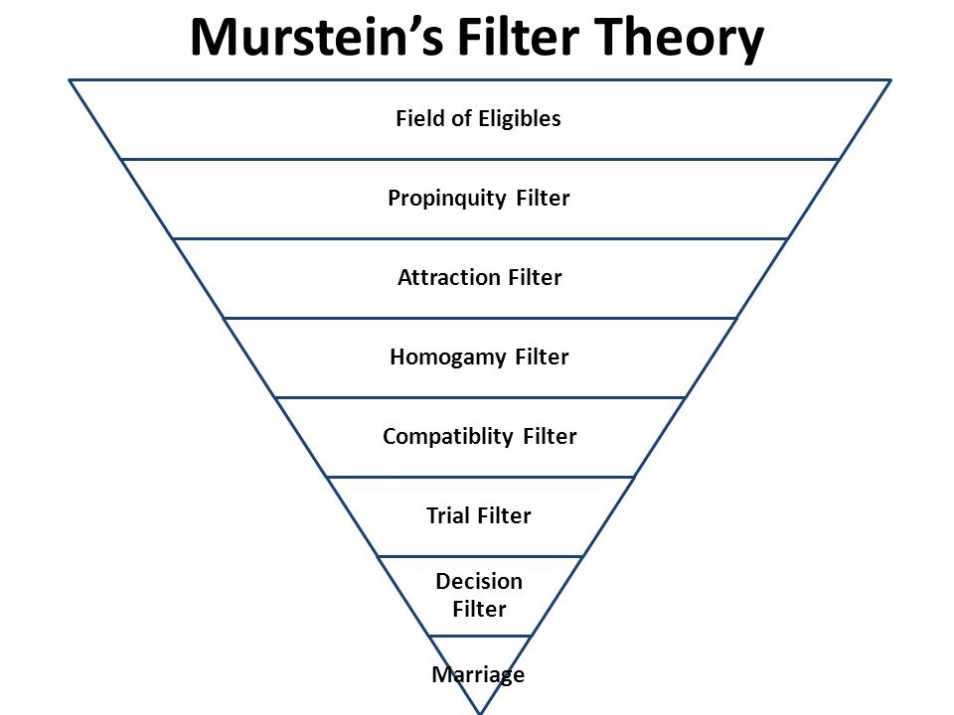

Slide 64
3 main types of abuse:
Physical:
easiest to recognize; bruising/cuts/death.
1/8 relationships involves violence
50% of battered wives report that they were beaten by husband before marriage.
Factors: men learn violent behaviour, violence is condoned, all about control
Emotional abuse:
Can take many forms
Two targets: self-esteem, independence
Sexual abuse:
Considered a crime in Canada
Rape is now called sexual assault
Old rape law: a man will be charged with rape when he has sexual intercourse with a woman who is not his wife.
Problems: women could not refuse husband sex
Had to be full penetration to count
Maximum punishment was life.
Low conviction rate because juries didn’t want to give life in prison, came down to his word against hers.
Past sexual history of women could be brought up.

Slide 65
Sexual Assault Statistics in Canada
A Numerical Representation of the Truth
Of every 100 incidents of sexual assault, only 6 are reported to the police
1 - 2% of "date rape" sexual assaults are reported to the police
1 in 4 North American women will be sexually assaulted during their lifetime
11% of women have physical injury resulting for sexual assault
Only 2 - 4% of all sexual assaults reported are false reports
60% of sexual abuse/assault victims are under the age of 17
over 80% of sex crime victims are women
80% of sexual assault incidents occur in the home
17% of girls under 16 have experienced some form of incest
83% of disabled women will be sexual assaulted during their lifetime
15% of sexual assault victims are boys under 16
half of all sexual offenders are married or in long term relationships
57% of aboriginal women have been sexually abused
1/5th of all sexual assaults involve a weapon of some sort
80% of assailants are friends and family of the victim

Slide 66
The previous noted statistics have been taken from various studies across Canada. While the numbers can never been 100% accurate, a few key generalizations can made:
sexual assault is far more common than most would suspect
relatively few incidents of sexual assault are reported to the police
young and otherwise vulnerable women are most likely to be sexually abused
most sexual assaults are committed by someone close to the victim, not a stranger

Slide 67
Myths and Facts of Sexual Assault, Canada
Dispelling Misconceptions and Promoting Awareness
Sexual assault and child sexual abuse are highly misunderstood crimes. Understanding the common misconceptions that are prevalent in our society along with the facts helps you better understand sexual assault and educate others:
MYTH: Most victims of sexual assault can prevent the assault from taking place by resisting. FACT: Assailants commonly overpower victims through threats and intimidation tactics. Moreover, many victims lack the capacity to appreciate or understand they are being assaulted.
MYTH: Most Sexual Assaults are done by strangers FACT: Statistics clearly show the vast majority of sexual assaults are committed by someone close to the victim

Slide 68
MYTH: Victims can easily "get over" the effects of sexual assault or child sexual abuse FACT: The effects of sexual assault are far reaching and can severely impact an individual's emotional stability, employment, and ability to form and maintain adult relationships.
MYTH: Most sexual assaults are not planned in advance. FACT: As many as 3/4ths of all sexual assaults involved some pre-planning by the asailant
MYTH: Sexual assault is a commonly false-reported crime FACT: Most statistics show approximately 2% or less of sexual assaults reported as false reports
MYTH: Victims commonly dress in a way that increases their chances of being sexual assaulted FACT: This appears to be uncommon as most assailants cannot remember what the victim was wearing

Slide 69
MYTH: If a drunk girl consents to a sexual act, this consent is valid FACT: It depends on how "drunk" the individual is and whether they are capable of understanding what they are consenting to
MYTH: Most victims are young, attractive females FACT: The elderly are commonly victims of sexual abuse.
MYTH: Men are never sexual assaulted. FACT: Sexual assault is more common for men than most believe, and boys are common victims of child sexual abuse
MYTH: Sexual assault is a relatively rare form of abuse FACT: As many as 1 in 4 women will be sexually assaulted during their lifetime. This makes sexual assault one of the most common serious crimes.

Slide 70
MYTH: Most assailants have a history of mental or sexual problems FACT: Many assailants appear to live highly normal/functioning lives
MYTH: Assailants are typically poor, uneducated, of a certain race FACT: There is no data indicating a typical profile of an assailant. Many assailants are otherwise upstanding citizens.
MYTH: It is not sexual assault if the assailant and the victim are married FACT: Any sexual acts that are not truly consented to constitute sexual assault regardless of the relationship between the victim and the assailant.
MYTH: The victim must show physical injuries for it to legally be considered a sexual assault. FACT: The presence or absence of physical injuries is irrelevant to the determination of whether an act is "legally" considered a sexual assault; however, physical injuries may be grounds for a heightened punishment or a finding of aggravated sexual assault.

