Slide 1
Unit 4: Parenting

Slide 2
Brief History of Parenting:
Middle Ages:
Upper classes had children to continue lineage
often sent away to a wet nurse
lower classes had children for labour
the lower classes nursed their own infants, and they followed parents to learn their work/trade.

Slide 3
Canada:
Aboriginal families:
valued equality of partners and caring attitude, corporal punishment not tolerated
European arrival changed role of women and children and created a huge systemic change
Euro-Canadians:
Carried Middle Ages traditions until Industrialization
changed from producers to consumers
education now compulsory
sex role stereotypes created/reinforced
fewer child-care responsibilities for older children

Slide 4
Read The Expanding Chinese Family and the Chinese Family today p.291 – 293
Read The Greek Family Today p.292

Slide 5
Current Trends in Childrearing
Social Exchange Theory
costs: financial, energy, time
benefits: emotional fulfillment, love
Dual Income Impact
1970s: 1/3 families had dual income
2002: 7/10 families had dual income
System theory: impact in all members

Slide 6
Women and Work-Force Participation
Traditionally, women worked until they were married.
Today, 7/10 couples with a child under 7 yrs have dual-earner families.
In nearly half of all families, women’s income =25 – 40 % of family income
In 25% of all families, women contribute to ½ or more of total family income

Slide 7
Due to career goals and work satisfaction, women are waiting to have children, and they have fewer when they do.
The majority of women are no longer at home caring for children for long periods of time.
Those who do stay at home do not have a large network of other stay-at-home parents to rely on.

Slide 8
Read Fertility Trends p.295-301 together as a class. Discuss charts.
Read Infertility section on p.309
Advances in reproductive technology now allow infertile couples to have . In the past, the only option was adoption.
NOW: artificial insemination of husband’s sperm
Artificial insemination of a donor’s sperm
In vitro fertilization

Slide 9
Lack of Support for Parents
society not seen as supportive of families
struggle to balance careers and families
workplaces do not allow enough flexibility for parents and have inadequate care programs.
Workplaces need to be more accommodating of parents in terms of:
hours they work
opportunity to work from home
ability to take time off to care for ill children
Despite all this: 90% of couples today have, or would like to have, babies.

Slide 10
Factors in decision to have children
age/infertility issues
divorce rates
improved infant mortality rates
societal views: 90 % Canadians have or intend to have children
Religion
economics: societal & personal
feelings about children
psychological readiness
genetic diseases
pressure from peers/parents
support from workplace and other career considerations

Slide 11
Read Considerations of Same Sex Couples p.313-314
When?
most women were 20-24 years old
shift to later: average age 29 at first child
1970: 14% were 30 – 34
1990: 30% were 30 – 34
How Many?
1960 average 3.8 per family
2000 average 1.5 per family
most families have 2 or 3

Slide 12
Baby boom — or bust? By Jason Heat http://business.financialpost.com/personal-finance/managing-wealth/baby-boom-or-bust
Canada's new baby boom may bust young couples' expenses
Canadians are waiting until later in life to have children, and recent census data suggests they are having more of them. So does that mean those extra years will be spent diligently saving for their parenting years?
Or instead are young people entrenching poor spending habits that will just be exacerbated when the costs of raising a family kick in?
The number of children under the age of five increased by 11% between 2006 and 2011 according to Statistics Canada census data
With proper planning, today’s young couples can potentially set themselves up to enter parenthood in better financial shape than previous generations who had children much earlier in life. They are on average better educated than their parents, have higher relative incomes and have more time to build up their savings to prepare for family life.
The number of children under the age of five increased by 11% between 2006 and 2011 according to Statistics Canada census data. This is the largest increase since the tail end of the Baby Boom period, 50 years ago. The last five years have also seen the fertility rate increase to 1.7 children per woman from 1.5.
The average age of a first-time mother in 1983 was 26.9 years of age. In 2012, 29 years later, the average first-time mother was well over 29 years old. Interestingly, the average age of brides has steadily increased to 31.5 years and for grooms, to 34 years.
Education is one of the primary reasons for delaying marriage and children. Women with a university degree have children an average of five years later than those without an undergraduate degree.

Slide 13
Why?
Longer schooling, delayed marriage
Later = fewer (biological clock)
Economics: buy a home, take leave, pay for child care
Older parents reflected in media
Contraception widespread and efficient
Couples who have their desired # of now perform permanent forms of birth control through tubal ligation or a vasectomy.

Slide 14
Case Study: Deciding to Have a Child: Emma and Sanjay’s Story p.316-317 Q 1-5
Childlessness
1993 survey: 35.2% couples were childless
9.6% expected to remain so.
Voluntary Childlessness
social exchange perspective: costs outweigh the benefits
marital satisfaction is higher among voluntary childless couples
Natural Childlessness/Infertility
lots of pressure, frustrations
years of fertility treatments, may ultimately be unsuccessful
impact on work, finances, social life

Slide 15
Adoption: read p.315 - 317

Slide 16
Parenting Styles
Canada is individualistic and independence
Many other cultures: reciprocity and obligation
3 Basic Styles:
Authoritarian
Use more physical punishment
Negative effects on child
Feel rejected

Slide 17
Permissive (Authority-less)
Warmth and encouragement; few boundaries
Irresponsible, impulsive, immature or flighty and anxious
Authoritative
Optimum balance of control and warmth
Read Impact of Parenting Style on Children p.335-337

Slide 18
Factors inhibiting good parenting:
Economic hardship
Maternal antisocial behaviour
Neighbourhood poverty
Positive parenting techniques can reduce impact of risks

Slide 19
Parent-Child Relationships
Attachment
Behaviours that meet the need of an infant to maintain or attain proximity and protection with a parent (physical contact and love)
Experiment in Attachment
Infants 6 – 24 months observed when a stranger is introduced
Securely attached: head for mother (of father is mom is absent)
Insecurely attached: avoid/resist parents

Slide 20
Attachment in later life
Secure:
better adjusted adults
Tend to come from higher incomes
Insecure:
difficulty with trust, empathy, self-esteem, relationships
Poor brain development leads to rage, anxiety, impulsiveness and violence
Read p.329-330 on Attachment

Slide 21
First 6 years
Brain development dependent on early stimulation: nutrition, stimulation, love and responsive care
Emotional and linguistic development key
Much easier to create stable people now than to fix them later

Slide 22
Multiple Births
Fraternal:
where two eggs are fertilized by two different sperm.
Identical:
one fertilized egg splits into two or more embryos that share the same genetic material.

Slide 23
How common are twins and other multiple births?
As of 2010, twins accounted for about 1 in 30 births in the United States – or 3.3 percent.
In Canada between 1991 and 2009, the rate of multiple births increased by more than 50 per cent, according to Statistics Canada.
1 in 726 births resulted in triplets or higher-order multiples.
the birth rate for twins rose by about 76 percent in the past 30 years. The rate of triplets and higher-order multiples quadrupled from 1980 to 1998, but then started to decline.

Slide 24
What caused the rise in multiples?
Age of mother. Women are waiting until they are older to have babies. As you get older, hormonal changes make it more likely that your body will release more than one egg at a time. And more than one fertilized egg often means more than one baby.
Use of fertility drugs and assisted reproductive technologies (ART). These treatments greatly increase a woman's chance of having twins or higher-order multiples.
The increase in twins has slowed over the past decade, possibly because fertility treatments have become more refined.

Slide 25
What about identical twins?
Meanwhile, the likelihood of having identical twins (which happens when one fertilized egg divides in half) is holding steady at about 1 in 285.
This rate hasn't changed over the decades and is remarkably constant all over the world.

Slide 26
Likelihood of multiples with fertility treatments:
Fertility drugs stimulate your ovaries, increasing the odds that you'll release several eggs at the same time.
in vitro fertilization (IVF): your chances of having more than one child are 20 to 40 percent, depending on how many embryos are placed in your womb.
IUI (intrauterine insemination): in which sperm are placed into the uterus with a syringe, is the only fertility treatment that doesn't increase the chances of conceiving multiples. But most women who undergo IUI also take a fertility drug, which does.

Slide 27
What other factors influence the probability of having fraternal twins?
Heredity: If you're a twin or if there are twins in your family, you're slightly more likely to have a set yourself.
Age: The older you are, the higher your chances of having fraternal twins or higher-order multiples. Women over 35 produce more follicle stimulating hormone (FSH) than younger women. Ironically, increasing levels of this hormone are a sign of declining fertility.
But FSH is also the hormone that causes an egg to mature in preparation for ovulation each month, and women with extra FSH may release more than one egg in a single cycle. So while older women are statistically less likely to get pregnant, they're more likely to have twins if they do get pregnant.

Slide 28
History of twins: Once you have a set of fraternal twins, you're twice as likely to have another set in future pregnancies.
Number of pregnancies: The more pregnancies you've had, the greater your chances of having twins.
Race: Twins are more common than average in African Americans and less common in Hispanics and Asians.
Body type: Twins are more common in large and tall women than in small women.
http://www.babycenter.com/

Slide 29
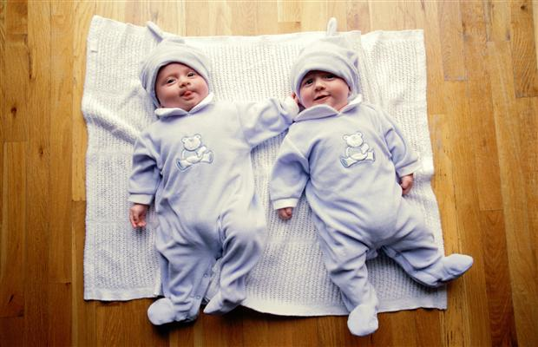
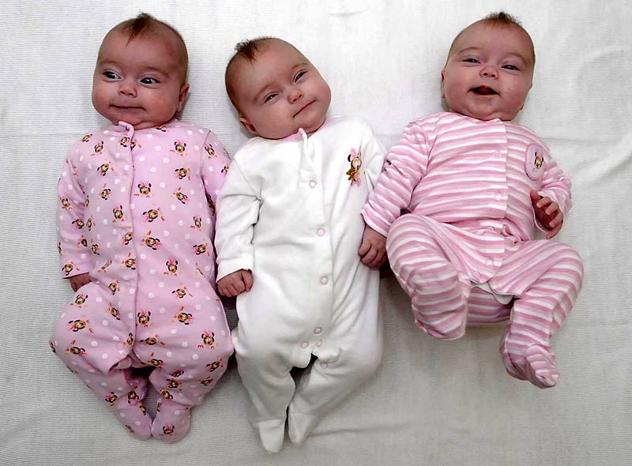
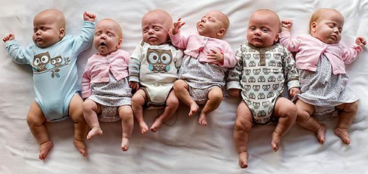
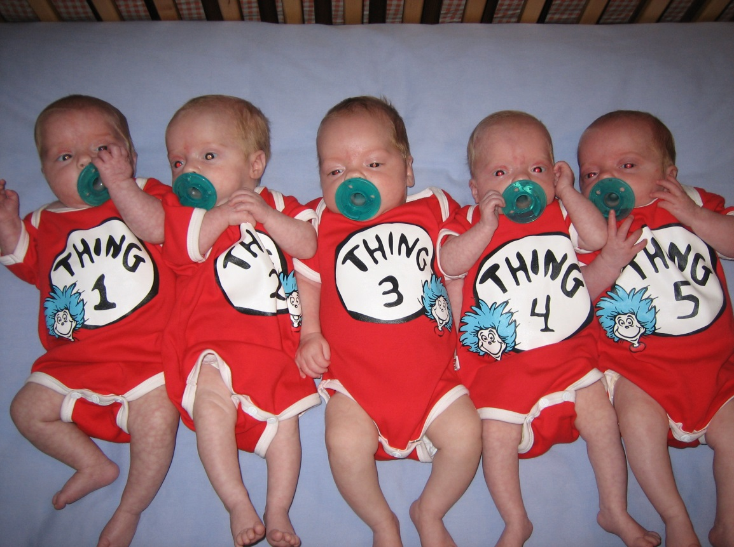
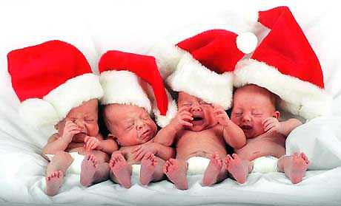

Slide 30
The Transition to Parenthood New text reference: p.322
Developmental Tasks
Accept new member
Move up a generation
Change in self-image
Renegotiate work, personal, family routine
Negotiate roles as primary caregivers
Re-negotiate household tasks

Slide 31
Marital Satisfaction
Initial decrease – lack of time for family, couple, friends, work, personal
e.g. TV, sleep, talking, sex, bathroom
Usually temporary drop
Best predictor for satisfaction after birth of a child is the satisfaction before.

Slide 32
Financial Adjustment
Raising a child can cost up to $10’000 a year.
Food, clothing, equipment, day care, work leave, post sec ed
In 2009, the basic parental leave benefit rate was 55% of an individual’s average insured earnings up to a yearly max amount of $42’300 ($3525/month).
Decline in men’s income since 1980; no more family wage

Slide 33
Taking Leave from Work
Identity shift (defined by work)
Lack of anticipatory socialization
Usually mother: satisfaction depends on amount of support/involvement of Dad.
Case study: Grant Enjoys Being a father.p.352-353 Q1-6

Slide 34
Teenage Parenthood
Read p.358-367
Define: diminished parenting ability, social risk factors
What are some effects on the child of teenage parents?
What are some effects on the parents of the teenaged parent?
Point of View: teenage father’s duties and rights p.366 Q1-4

Slide 35
http://www.parents.com/videos/v/63983316/sperm-meets-egg-weeks-1-to-3-of-pregnancy.htm

Slide 36
Pregnancy nutrition: Foods to avoid during pregnancy
Avoid seafood high in mercury
Seafood can be a great source of protein, and the omega-3 fatty acids in many fish can promote your baby's brain and eye development. However, some fish and shellfish contain potentially dangerous levels of mercury.
Too much mercury could harm your baby's developing nervous system.
The bigger and older the fish, the more mercury it's likely to contain. The Food and Drug Administration (FDA) and the Environmental Protection Agency (EPA) encourage pregnant women to avoid:
Swordfish
Shark
King mackerel
Tilefish

Slide 37
So what's safe?
Some types of seafood contain little mercury. The 2010 Dietary Guidelines for Americans recommend 8 to 12 ounces — two average meals — of seafood a week for pregnant women. Consider:
Shrimp
Salmon
Pollock
Catfish
Anchovies
Trout
However, limit albacore tuna and tuna steak to no more than 6 ounces (170 grams) a week. Also, be aware that while canned light tuna on average appears safe, some testing has shown that mercury levels can vary from can to can.

Slide 38
Avoid raw, undercooked or contaminated seafood
To avoid harmful bacteria or viruses in seafood:
Avoid raw fish and shellfish. Examples include sushi, sashimi, and raw oysters, scallops or clams.
Avoid refrigerated, uncooked seafood. Examples include seafood labeled nova style, lox, kippered, smoked or jerky. It's OK to eat smoked seafood if it's an ingredient in a casserole or other cooked dish. Canned and shelf-stable versions also are safe.
Cook seafood properly. Cook fish to an internal temperature of 145 F (63 C). Fish is done when it separates into flakes and appears opaque throughout. Cook shrimp, lobster and scallops until they're milky white. Cook clams, mussels and oysters until their shells open. Discard any that don't open.

Slide 39
Avoid undercooked meat, poultry and eggs
During pregnancy, you're at increased risk of bacterial food poisoning. Your reaction might be more severe than if you weren't pregnant. Rarely, food poisoning affects the baby, too.
To prevent foodborne illness:
Fully cook all meats and poultry before eating. Use a meat thermometer to make sure.
Cook hot dogs and luncheon meats until they're steaming hot — or avoid them completely. They can be sources of a rare but potentially serious foodborne illness known as listeriosis.
Avoid refrigerated pates and meat spreads. Canned and shelf-stable versions, however, are OK.
Cook eggs until the egg yolks and whites are firm. Raw eggs can be contaminated with harmful bacteria. Avoid foods made with raw or partially cooked eggs, such as eggnog, raw batter, and freshly made or homemade hollandaise sauce and Caesar salad dressing.

Slide 40
Avoid unpasteurized foods
Many low-fat dairy products — such as skim milk, mozzarella cheese and cottage cheese — can be a healthy part of your diet. Anything containing unpasteurized milk, however, is a no-no. These products could lead to foodborne illness. Avoid soft cheeses, such as Brie, feta and blue cheese, unless they are clearly labeled as being pasteurized or made with pasteurized milk. Also, avoid drinking unpasteurized juice.

Slide 41
Avoid excess caffeine
Caffeine can cross the placenta and affect your baby's heart rate. While further research is needed, some studies suggest that drinking too much caffeine during pregnancy might be associated with an increased risk of miscarriage.
Because of the potential effects on your developing baby, your health care provider might recommend limiting the amount of caffeine in your diet to less than 200 milligrams a day during pregnancy. For perspective, an 8-ounce (237-milliliter) cup of brewed coffee contains about 95 milligrams of caffeine, an 8-ounce (237-milliliter) cup of brewed tea contains about 47 milligrams and a 12-ounce (355-milliliter) caffeinated cola soft drink contains about 33 milligrams.

Slide 42
Avoid herbal tea
There's little data on the effects of specific herbs on developing babies. As a result, avoid drinking herbal tea unless your health care provider says it's OK — even the types of herbal tea marketed specifically to pregnant women.
Avoid alcohol
One drink isn't likely to hurt your baby, but no level of alcohol has been proved safe during pregnancy. The safest bet is to avoid alcohol entirely.
Consider the risks. Mothers who drink alcohol have a higher risk of miscarriage and stillbirth. Too much alcohol during pregnancy can result in fetal alcohol syndrome, which can cause facial deformities, heart defects and mental retardation. Even moderate drinking can impact your baby's brain development.
If you're concerned about alcohol you drank before you knew you were pregnant or you think you need help to stop drinking, consult your health care provider.

Slide 43
Things No One Tells You About Being Pregnant
https://www.youtube.com/watch?v=n9xESA3UawA
Stages of labour website:
http://americanpregnancy.org/labor-and-birth/first-stage-of-labor/
Men React To Pregnancy Facts:
https://www.youtube.com/watch?v=XNosUEzteac
Women React To Pregnancy Facts:
https://www.youtube.com/watch?v=WFDkb3ZuJTY
http://www.msichicago.org/experiment/make-room-for-baby/

Slide 44
People Who Help in the Birthing Process
Doctor
Partner/coach
Doula
Midwife

Slide 45
What is a doula?
The word "doula" comes from the ancient Greek meaning "a woman who serves" and is now used to refer to a trained and experienced professional who provides continuous physical, emotional and informational support to the mother before, during and just after birth; or who provides emotional and practical support during the postpartum period.
A Birth Doula
Recognizes birth as a key experience the mother will remember all her life
Understands the physiology of birth and the emotional needs of a woman in labor
Assists the woman in preparing for and carrying out her plans for birth
Stays with the woman throughout the labor
Provides emotional support, physical comfort measures and an objective viewpoint, as well as helping the woman get the information she needs to make informed decisions
Facilitates communication between the laboring woman, her partner and her clinical care providers
Perceives her role as nurturing and protecting the woman's memory of the birth experience
Allows the woman's partner to participate at his/her comfort level

Slide 46
A Birth Doula
Recognizes birth as a key experience the mother will remember all her life
Understands the physiology of birth and the emotional needs of a woman in labor
Assists the woman in preparing for and carrying out her plans for birth
Stays with the woman throughout the labor
Provides emotional support, physical comfort measures and an objective viewpoint, as well as helping the woman get the information she needs to make informed decisions
Facilitates communication between the laboring woman, her partner and her clinical care providers
Perceives her role as nurturing and protecting the woman's memory of the birth experience
Allows the woman's partner to participate at his/her comfort level

Slide 47
A Postpartum Doula
Offers education, companionship and nonjudgmental support during the postpartum fourth trimester
Assists with newborn care, family adjustment, meal preparation and light household tidying
Offers evidence-based information on infant feeding, emotional and physical recovery from birth, infant soothing and coping skills for new parents and makes appropriate referrals when necessary

Slide 48
How do I know when I am in labour?
Every mom's labour is different, and pinpointing when it begins is not really possible. It's more of a process than a single event, when a number of changes in your body work together to help you give birth. In early labour, also called the latent phase you may feel the following:
Persistent lower back or abdominal pain, often accompanied by a crampy premenstrual feeling.
A bloody show (a brownish or blood-tinged mucus discharge). If you pass the mucus plug that blocks the cervix, labour could be imminent or it could be several days away. It's a sign that things are moving along.
Painful contractions that occur at regular and increasingly shorter intervals and become longer and stronger in intensity.

Slide 49
Broken waters, but you're in labour only if it's accompanied by contractions that are dilating your cervix.
How you will feel in early labour depends on whether you've had a baby before, how you perceive and respond to pain, and how prepared you are for what labour may be like.
When should I contact my doctor or midwife?
You, your doctor and midwife have probably talked about what to do when you think you're in labour. But if you think the time has come, don't be embarrassed to call. Doctors and midwives are used to getting calls from women who are uncertain if they're in labour and who need guidance - it's part of their job. And the truth is that your doctor or midwife can tell a lot by the tone and tenor of your voice, so verbal communication helps. Your provider will want to know how close together your contractions are, whether you can talk through a contraction, and any other symptoms you may have.

Slide 50
The stages of Labour
1. Early labour During early labour, your cervix starts to open and widen. It'll go from being closed to about 3cm or 4cm dilated. It may feel like the mild cramps you get with your period, or a dull ache or backache. You may even be several centimetres dilated before you realize you're in labour. Many women, however, notice that they're getting increasingly painful contractions and that they're coming regularly. You'll have your own rhythm and pace of labour. As a rough guide, early contractions are more than five minutes apart and short, perhaps only 30 or 40 seconds long. You'll be able to talk through them and carry on with your normal routine, if you want to. For some women, early labour starts and stops. For others, it progresses smoothly into active labour.

Slide 51
2. Active phase of labour As labour progresses your contractions usually become longer and more frequent. You've moved into the active phase of labour. This is when your cervix opens from 3cm or 4cm to 10cm.
Contractions are more powerful now. A contraction usually starts gradually, building up to a peak of intensity before fading away. You probably won’t be able to talk through these contractions. You may have to stop and breathe through them. Relaxation techniques will help you to keep calm and control your breathing. Contractions may come as often as every three to four minutes and last 60 to 90 seconds. They'll feel very intense. Between contractions, you'll be able to talk, move around, have a drink or something to eat, and prepare yourself for the next one. Contractions in the active phase open your cervix more rapidly, but it may still be many hours before your cervix is fully dilated.

Slide 52
What happens in the third stage of labour?
Once your baby is born, the third stage begins. Contractions, weaker this time, will start up again. These will make the placenta gradually peel away from the wall of your uterus. You may get the urge to push again. The placenta, with the membranes of the empty bag of waters attached, will drop to the bottom of your uterus and out through your vagina.
Your midwife or doctor will examine the placenta and membranes to make sure that nothing has been left behind. She will also feel your tummy to check that your uterus is contracting hard to stop the bleeding from the place where the placenta was attached.
You may want to have a look at the placenta. After all, it has been your baby's lifeline through your pregnancy. Tips for the third stage Hold your new baby next to your skin and, if you're going to breastfeed, offer your breast as soon as possible. This will stimulate hormones to make the placenta separate.
http://www.babycenter.ca/a177/the-stages-of-childbirth#ixzz497lf8ogY

Slide 53
Family Structure and Parent-Child Roles
Lone-parent-families are increasing
Children born in 1960s – 25% by age 20
1980s – 22% by age 6
1990 – 37% by age 4
Factors which affect success of children from lone-parent families:
gender of parent
reason: divorce, never married, widowed
resources available: $, time, friends, family
ex. Children in divorced, single-mother homes achieve less education, occupation and life satisfaction than those with widowed single mothers.

Slide 54
More fathers are maintaining contact after divorce and acknowledging paternity if not married.
Conflict:
Destructive conflict – blaming
Constructive conflict – problem-solving
Marital conflict has negative effects on kids but parent-child conflict has more negative effects, especially in adolescence

Slide 55
Read Gender Socialization p.337 – 339
Read Care of children by grandparents p. 347 – 349. Define custodial grandparents.
Read section on daycare p.350 – 351
Read children of Divorced parents
p. 368-373 Define physical custody, joint custody, shared custody.
Read study on p.375 Q 1,4,5
Read POV Rich Nation, Poor children,
answer Q 1-3 p.380

Slide 56
Read Death of a Child p.381-385
P382 Q 1-3
How does functionalism, systems theory and exchange theory describe the effect on the family and society?
What is the impact on parents?
What effect does it have on siblings?
Case study: Donald and Louisa Face their Loss p.386-387 Q1-4

